Slide 1


Project Presentation and Demonstration
WEB DESIGN PLATFORM
Based On Low-code
Visual Components
2023
2023
Name: Ruitong(Aurora) Xiao

Slide 2


CONTENTS
01/ Introduction
03/
Background Review
05/
Implementation & Result
02/
Motivation
04/
Methodology
06/
Conclusion
1

Slide 3


Project Presentation and Demonstration
Introduction
What is low-code?
Less code.
Faster development.
Lower technical barriers
What is a low code development platform ?
01
A software development tool.
Provides a graphical user interface and visual components [1].
Enables users to create software applications with less coding [2].
2

Slide 4



Introduction
Project Presentation and Demonstration
Aim
Audience
Citizen developers [3]
1. Non-professional, non-technical background
2. Has some business knowledge and creativity
3. Usually employees within the company
This project presents a low-code development platform based on visual components that provide citizen developers [3] with an opportunity to rapidly and economically design websites.
3

Slide 5
Project Presentation and Demonstration
Motivation
What is the problem?
Why I choose this project?
Enables non-professionals to develop websites that meet their demands
High costs and long development cycles for traditional development methods
02
Why is it interesting?
1. Low-code development platforms are a hot topic in the current technology landscape
2. Explore and implement innovative development methods and tools
4

Slide 6

Project Presentation and Demonstration
Background Review
Representative leading platforms for further analysis and comparison
1. Mendix
2. Microsoft Power Apps
3. OutSystems
03
5

Slide 7


Background Review
Project Presentation and Demonstration
Mendix [4]
Microsoft Power
Apps [5]
OutSystems [6]
Drag-and-drop
application
Multi-type forms
Pre-built modules
Code generation
Cloud deployment
6

Slide 8
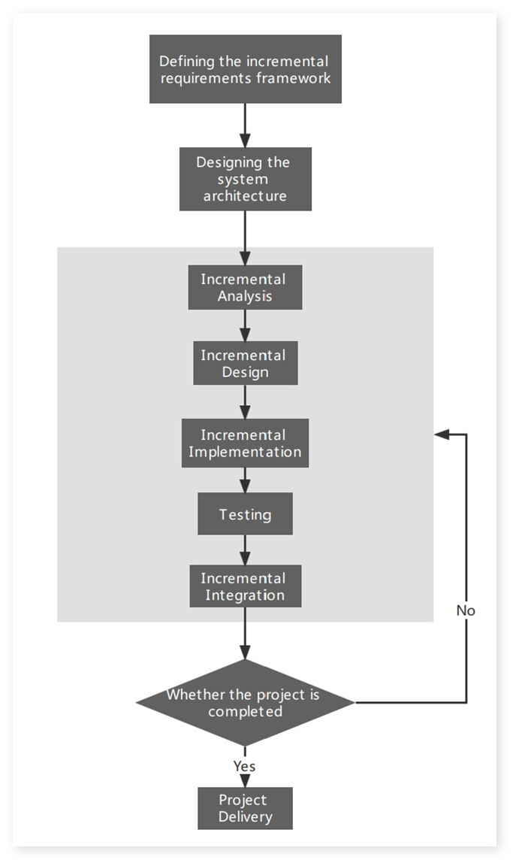

04
Methodology
Incremental Development Model
The incremental model was chosen to be the software development method for this project, decomposing the project into multiple interrelated task modules in accordance with the various functional requirements.
Competitive Feature Analysis
The requirements gathering methods involved analysing and comparing the features and functions of competing products in the same field to gain a thorough understanding of the product landscape.
Project Presentation and Demonstration
7
Figure 1.Incremental Development Model Flowchart

Slide 9










Methodology
Project Presentation and Demonstration
Design Tools
Xmind
ProcessOn
Figma
Development Tools
Vue
Vite
VS Code
Testing Tools
Selenium IDE
PyCharm
8

Slide 10
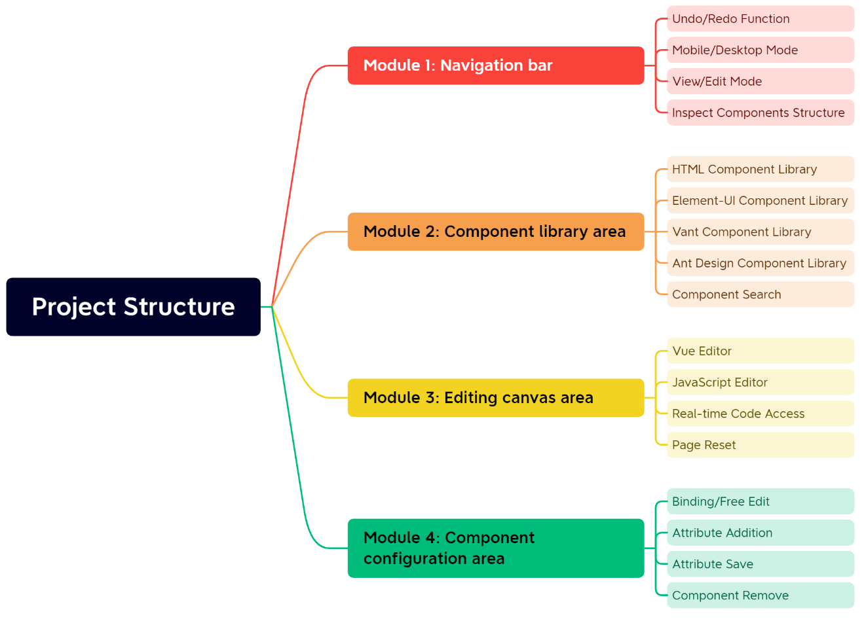
05
Implementation & Result
Project Structure
The project consists of four main modules:
Navigation Bar - Page editing and previewing
Component Library Area - Integrate component libraries and basic HTML elements
Editing Canvas Area - Code editing, previewing, and page deletion
Component Configuration Area - Edit component properties.
Figure 2. Project Structure Diagram
Project Presentation and Demonstration
9

Slide 11
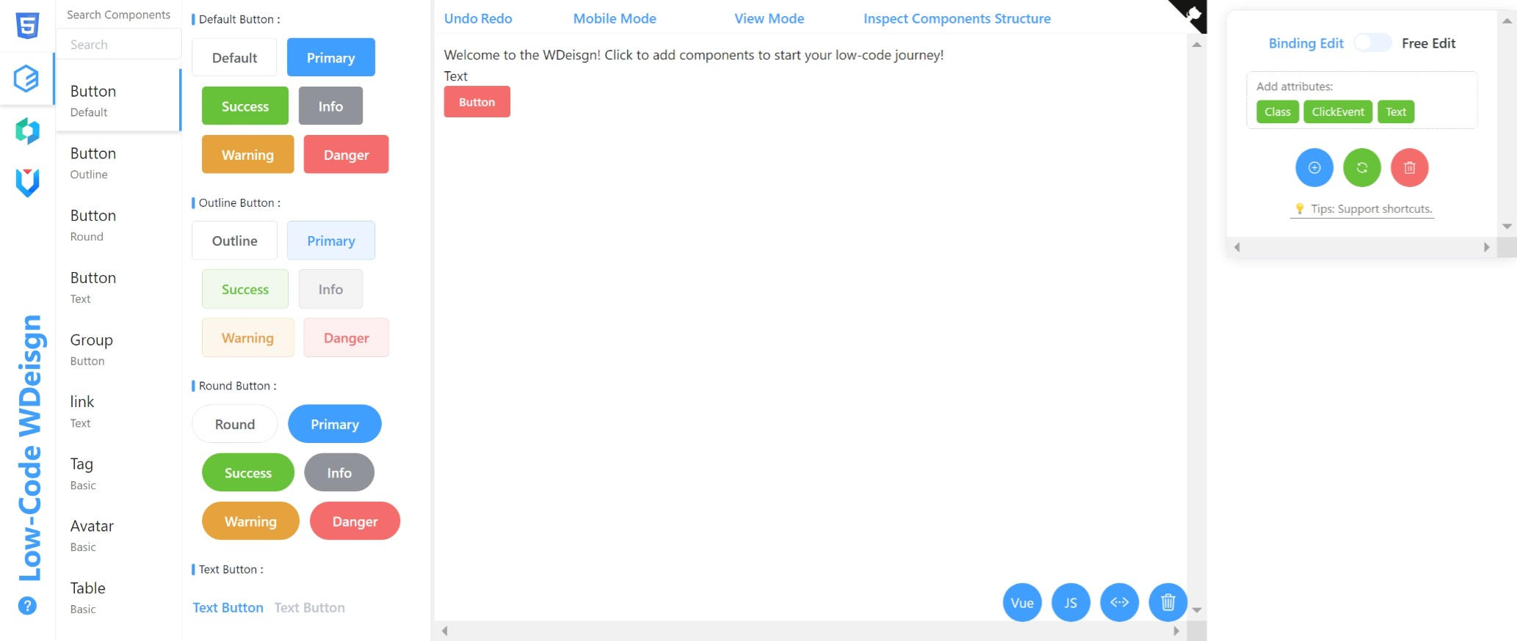
Implementation & Result
Navigation bar
Provides the functions of Undo/Redo, Mobile/Desktop Mode, View/Edit Mode and Inspect Components Structure.
Editing Page
Component Configuration Area
Provides component deletion, component attribute editing, adding and removing functions, and supports both binding and free editing modes.
Component Library Area
Provides three different component libraries and the functionality to search for components, but only within the currently selected component library.
Screenshot 1. Editing Page
Editing Canvas Area
Providing functions such as web code editing, preview, and web page deletion
10

Slide 12
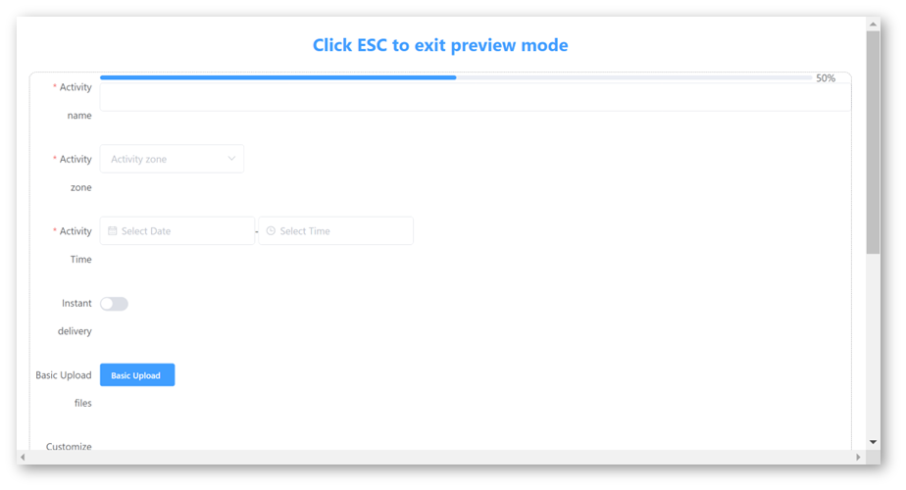
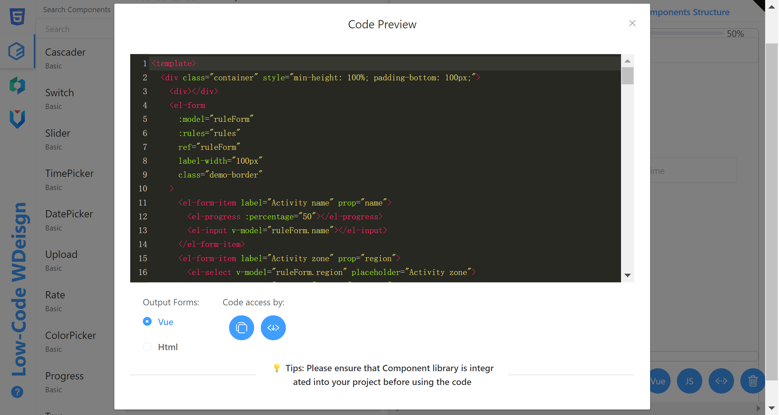
Implementation & Result
Project Presentation and Demonstration
11
1
Page Preview
2
Code Preview
Provide visual page preview function, view the effect of the web page through the web preview function during the web page editing process.
Provides real-time code modification and copying, as well as download projects in different output formats such as Vue and HTML.
Screenshot 3. Page Preview
Screenshot 4. Code Preview

Slide 13
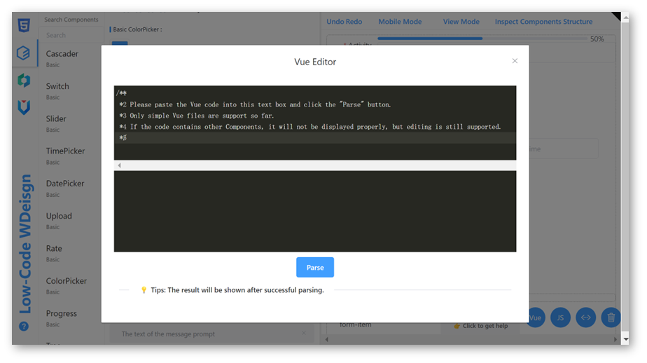
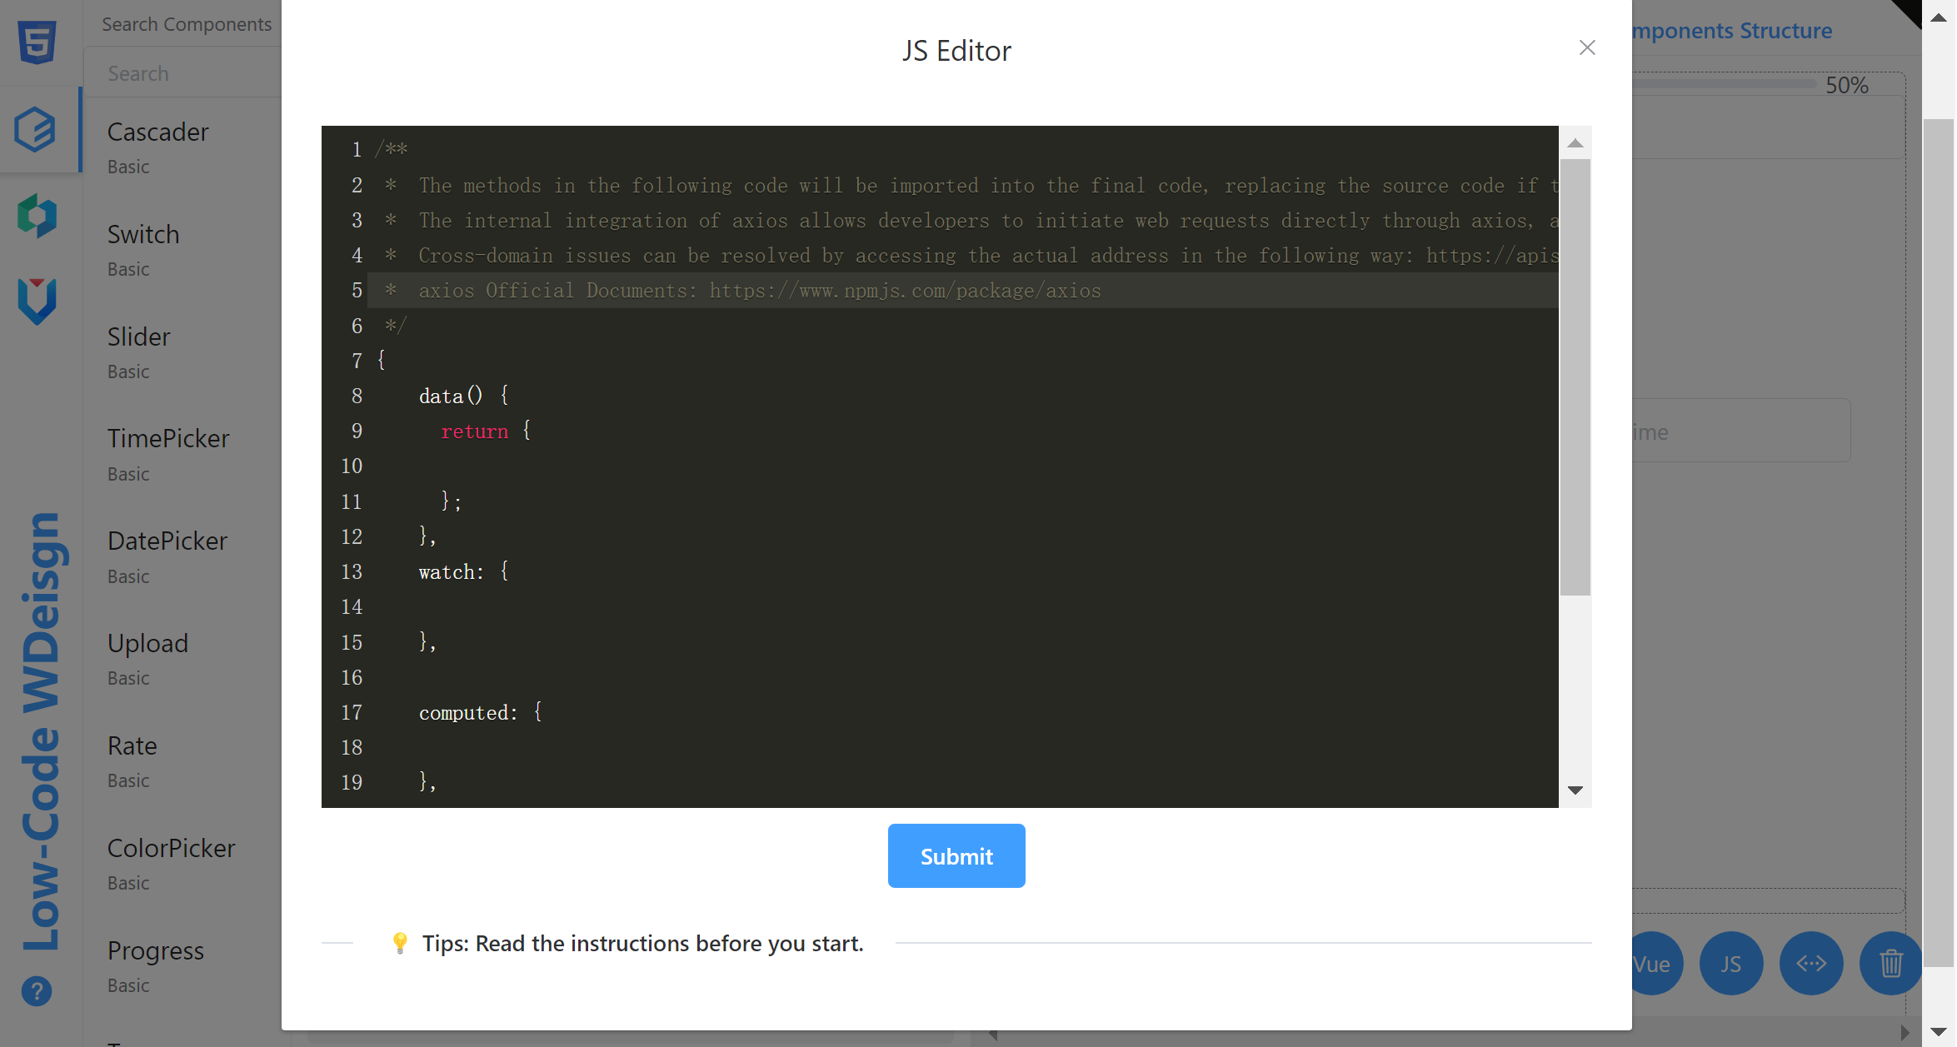
Implementation & Result
Project Presentation and Demonstration
12
1
Vue Editor
2
JavaScript Editor
Provides secondary editing functionality to import and parse Vue code.
Provide logical editing function, users can modify or import the JS code of the editing page, and view the result by attributes save function and preview function.
Screenshot 3. Page Preview
Screenshot 4. Code Preview

Slide 14

06
Conclusion
Achievements
Limitation
Future Work
Drag And Drop Components
No free drag and drop
Further Component Libraries
Visualisation
Limited component libraries
User Project Management
Code Generation
No project storage and management function
On-line collaboration
Web Import and Export
Platform security
Platform security vulnerabilities exist
Inspect Components Structure
Cloud Deployment
Page Preview
Project Presentation and Demonstration
13

Slide 15
THANK YOU
Web Design Platform Based On Low-code Visual Components
14

Slide 16

Reference
[1] Sanchis, García-Perales, Fraile, and Poler, “Low-Code as Enabler of Digital Transformation in Manufacturing Industry,” Applied Sciences, vol. 10, no. 1, p. 12, Dec. 2019, doi: https://doi.org/10.3390/app10010012.
[2] R. Waszkowski, “Low-code platform for automating business processes in manufacturing,” IFAC-PapersOnLine, vol. 52, no. 10, pp. 376–381, 2019, doi: https://doi.org/10.1016/j.ifacol.2019.10.060.
[3] M. Oltrogge et al., ‘The Rise of the Citizen Developer: Assessing the Security Impact of Online App Generators’, in Proceedings - IEEE Symposium on Security and Privacy, Jul. 2018, vol. 2018-May, pp. 634–647. doi: 10.1109/SP.2018.00005.
[4] “Mendix Low-Code Platform Features - Low-Code App Development Tools,” Mendix. https://www.mendix.com/platform/
[5]“Business Apps | Microsoft Power Apps,” powerapps.microsoft.com. https://powerapps.microsoft.com/
[6]“The Modern Application Development Platform | OutSystems,” outsystems.com. Accessed: Nov. 28, 2021. [Online]. Available: https://www.outsystems.com/platform/
15

